Slide 1
Android Studio

Slide 2
Component of Android Apps
Activities
Services
Broadcast Receivers
Content Providers

Slide 3
Component of Android App
Activities :-
It is a class that represents a single Screen with a user interface.
Service :-
Service is a background process that can run for a long time operation.
Service doesn’t provide a user interface.
There are two types of services, that till the system how to manage an app
  Started Service
  Bound Service

Slide 4
Components of Android App
Started Service :-
Tell the system to keep then running until their work is completed.
There are two parts 1.Foreground 2.Background
Foreground:-
The user is directly interaction with application.(user can see the application)
Background:-
The user is not directly. So the system has more freedom in manging it’s process.(user cannot see the application)

Slide 5
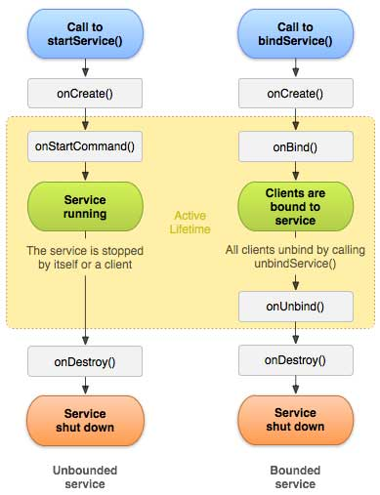
Components of Android App
Bound service:-
It client service interface that allows
components to interact with the service,
sent request, receiver result, then process
with interprocess communicate (IPC) is
performed.

Slide 6
Component of Android App
There are two service classes
  Standard service class
  Intent service class
Standard Service Class :-
Service class has feature uses the main thread of the application.
If the service uses most of this share, your application will slow down.
If your service has a big task, you should not use this standard service class.

Slide 7
Components of Android Apps
Intent Service Class :-
Intent service class is a subclass of the service class.
It does not use main thread of the application.
Class request and other share of the processor from Android Operation system.
StopSelf() → Your background running operation is done, service is automatically stopped.
OnHandleIntent →Service itself will be stop. Work is finished service will be stop automatically. When it finishes the task the stops the service itself.

Slide 8
Components of Android Apps
Broadcast Receiver :-
The Broadcast receiver is a messaging system used on Android devices.
Message System is used between the Android Operation system and Android application.
The Android Operation System Shares devices related information with Android application.
Devices related information like battery level, WiFi or Not
It will subscribe to the OS in order to get this information.
The Android OS sends a broadcast receiver message to the application.
Broadcast message system can be used between two applications.
One application can send a broadcast message to another application.

Slide 9
Components of Android App
Declare in Broadcast Receiver in two ways
Manifest file
Context Register
<receiver android:name=".MyReceiver">
android:permission = “ “ >
<intent-filter>
<action android:name="android.intent.action.BOOT_COMPLETED"/>
<action android:name="com.example.CUSTOM_ACTION"/>
</intent-filter>
</receiver>

